Slide 1



Datalog and Emerging Applications: an Interactive Tutorial
Shan Shan Huang T.J. Green Boon Thau Loo
SIGMOD 2011 Athens, Greece June 14, 2011

Slide 2







A Brief History of Datalog
Declarative networking
Control + data flow
BDDBDDB
SecureBlox
Orchestra CDSS
Workshop on Logic and Databases
Data integration
Information Extraction
Hey wait… there ARE applications!
No practical applications of recursive query theory … have been found to date.
-- Hellerstein and Stonebraker
“Readings in Database Systems”
‘77
’80s …
‘95
‘02
‘05
‘07
‘08
‘10
Doop
(pointer-analysis)
Access control (Binder)
LDL, NAIL, Coral, ...
Evita Raced
.QL
Notes:
Add recursion quote of

Slide 3
Today’s Tutorial, or, Datalog: Taste it Again for the First Time
We review the basics and examine several of these recent applications
Theme #1: lots of compelling applications, if we look beyond payroll / bill-of-materials / ...
Some of the most interesting work coming from outside databases community!
Theme #2: language extensions usually needed
To go from a toy language to something really usable

Slide 4

An Interactive Tutorial
(Asynchronously!)
^
INSTALL_LB : installation guide
README : structure of distribution files
Quick-Start guide : usage
*.logic : Datalog examples
*.lb : LogicBlox interactive shell script (to drive the Datalog examples)
Shan Shan and other LogicBlox folks will be available immediately after talk for the “synchronous” version of tutorial

Slide 5
Outline of Tutorial
June 14, 2011: The Second Coming of Datalog!
Refresher: Datalog 101
Application #1: Data Integration and Exchange
Application #2: Program Analysis
Application #3: Declarative Networking
Conclusions

Slide 6
Datalog Refresher: Syntax of Rules
Datalog rule syntax:
<result> ← <condition1>, <condition2>, … , <conditionN>.
Head
Body
Body consists of one or more conditions (input tables)
Head is an output table
Recursive rules: result of head in rule body

Slide 7
Example: All-Pairs Reachability
R1: reachable(S,D) <- link(S,D).
R2: reachable(S,D) <- link(S,Z), reachable(Z,D).
“For all nodes S,D, If there is a link from S to D, then S can reach D”.
link(a,b) – “there is a link from node a to node b”
reachable(a,b) – “node a can reach node b”
Input: link(source, destination)
Output: reachable(source, destination)

Slide 8
Example: All-Pairs Reachability
R1: reachable(S,D) <- link(S,D).
R2: reachable(S,D) <- link(S,Z), reachable(Z,D).
“For all nodes S,D and Z, If there is a link from S to Z, AND Z can reach D, then S can reach D”.
Input: link(source, destination)
Output: reachable(source, destination)

Slide 9
Terminology and Convention
An atom is a predicate, or relation name with arguments.
Convention: Variables begin with a capital, predicates begin with lower-case.
The head is an atom; the body is the AND of one or more atoms.
Extensional database predicates (EDB) – source tables
Intensional database predicates (IDB) – derived tables
reachable(S,D) <- link(S,Z), reachable(Z,D) .

Slide 10
Negated Atoms
Not “cut” in Prolog. ☺
We may put ! (NOT) in front of a atom, to negate its meaning.
Example: For any given node S, return all nodes D that are two hops away, where D is not an immediate neighbor of S.
twoHop(S,D)
<- link(S,Z),
link(Z,D)
! link(S,D).
link(S,Z)
link(Z,D)
S
Z
D

Slide 11
Safe Rules
Safety condition:
Every variable in the rule must occur in a positive (non-negated) relational atom in the rule body.
Ensures that the results of programs are finite, and that their results depend only on the actual contents of the database.
Examples of unsafe rules:
s(X) <- r(Y).
s(X) <- r(Y), ! r(X).

Slide 12
Semantics
Model-theoretic
Most “declarative”. Based on model-theoretic semantics of first order logic. View rules as logical constraints.
Given input DB I and Datalog program P, find the smallest possible DB instance I’ that extends I and satisfies all constraints in P.
Fixpoint-theoretic
Most “operational”. Based on the immediate consequence operator for a Datalog program.
Least fixpoint is reached after finitely many iterations of the immediate consequence operator.
Basis for practical, bottom-up evaluation strategy.
Proof-theoretic
Set of provable facts obtained from Datalog program given input DB.
Proof of given facts (typically, top-down Prolog style reasoning)

Slide 13
The “Naïve” Evaluation Algorithm
Start:
IDB = 0
Start by assuming all IDB relations are empty.
Repeatedly evaluate the rules using the EDB and the previous IDB, to get a new IDB.
End when no change to IDB.
Apply rules
to IDB, EDB
yes
Change
to IDB?
no
done

Slide 14
Naïve Evaluation
reachable
link
reachable(S,D) <- link(S,D).
reachable(S,D) <- link(S,Z),
reachable(Z,D).

Slide 15
Semi-naïve Evaluation
Since the EDB never changes, on each round we only get new IDB tuples if we use at least one IDB tuple that was obtained on the previous round.
Saves work; lets us avoid rediscovering most known facts.
A fact could still be derived in a second way.

Slide 16
Semi-naïve Evaluation
reachable
link
reachable(S,D) <- link(S,D).
reachable(S,D) <- link(S,Z),
reachable(Z,D).

Slide 17
Recursion with Negation
Example: to compute all pairs of disconnected nodes in a graph.
reachable(S,D) <- link(S,D).
reachable(S,D) <- link(S,Z), reachable(Z,D).
unreachable(S,D) <- node(S), node(D), ! reachable(S,D).
unreachable
Stratum 1
Precedence graph :
Nodes = IDB predicates.
Edge q <- p if predicate q depends on p.
Label this arc “–” if the predicate p is negated.
--
reachable
Stratum 0

Slide 18
Stratified Negation
unreachable
reachable(S,D) <- link(S,D).
reachable(S,D) <- link(S,Z),
reachable(Z,D).
unreachable(S,D) <- node(S),
node(D),
! reachable(S,D).
Stratum 1
--
reachable
Stratum 0
Straightforward syntactic restriction.
When the Datalog program is stratified, we can evaluate
IDB predicates lowest-stratum-first.
Once evaluated, treat it as EDB for higher strata.
Non-stratified example:
p(X) <- q(X), ! p(X).

Slide 19
A Sneak Preview…
Data integration
Skolem functions
Program analysis
Type-based optimization
Declarative networking
Aggregates, aggregate selections
Incremental view maintenance
Magic sets

Slide 20
Suggested Readings
Survey papers:
A Survey of Research on Deductive Database Systems, Ramakrishnan and Ullman, Journal of Logic Programming, 1993
What you always wanted to know about datalog (and never dared to ask), by Ceri, Gottlob, and Tanca.
An Amateur’s Expert’s Guide to Recursive Query Processing, Bancilhon and Ramakrishnan, SIGMOD Record.
Database Encyclopedia entry on “DATALOG”. Grigoris Karvounarakis.
Textbooks:
Foundations in Databases. Abiteboul, Hull, Vianu.
Database Management Systems, Ramakrishnan and Gehkre. Chapter on “Deductive Databases”.
Acknowledgements:
Jeff Ullman’s CIS 145 class lecture slides.
Raghu Ramakrishnan and Johannes Gehrke’s lecture slides for Database Management Systems textbook.

Slide 21
Outline of Tutorial
June 14, 2011: The Second Coming of Datalog!
Refresher: Datalog 101
Application #1: Data Integration and Exchange
Application #2: Program Analysis
Application #3: Declarative Networking
Conclusions

Slide 22
Datalog for Data Integration
Motivation and problem setting
Two basic approaches:
virtual data integration
materialized data exchange
Schema mappings and Datalog with Skolem functions

Slide 23
The Data Integration Problem
Have a collection of related data sources with
different schemas
different data models (relational, XML, plain text, ...)
different attribute domains
different capabilities / availability
Need to cobble them together and provide a uniform interface
Want to keep track of what came from where
Focus here: solving problem of different schemas (schema heterogeneity) for relational data

Slide 24
Mediator-Based Data Integration
Basic idea: use a global mediated schema to provide a uniform query interface for the heterogeneous data sources .
Global mediated schema
?
?
?
?
Source schemas
Local data sources

Slide 25
Mediator-Based Virtual Data Integration
Query over global schema
Integrated query results
Query may be recursive
Global mediated schema
Query results
Declarative schema mappings
Reformulated query over local schemas
Source schemas
Reformulation may be (necessarily) recursive
Local data sources

Slide 26
Materialized Data Exchange
Query results
Declarative schema mappings
Query
Mappings may be recursive
Materialized
mediated (target) database
Global mediated schema
(aka target schema)
Data exchange step
(construct mediated DB)
Declarative schema mappings
Source schema(s)
Local data source(s)

Slide 27
Peer-to-Peer Data Integration (Virtual or Materialized)
Query
Results
Peer A
Peer E
Query
Peer C
Recursion arises naturally as peers add mappings to each other
Results
Peer B
Peer D

Slide 28
How to Specify Mappings?
Many flavors of mapping specifications: LAV, GAV, GLAV, P2P, “sound” versus “exact”, ...
Unifying formalism: integrity constraints
different flavors of specifications correspond to different classes of integrity constraints
We focus on mappings specified using tuple-generating dependencies (a kind of integrity constraint)
These capture (sound) LAV and GAV as special cases, and much of GLAV and P2P as well
and, close relationship with Datalog!

Slide 29
Logical Schema Mappings via Tuple-Generating Dependencies (tgds)
A tuple-generating dependency (tgd) is a first-order constraint of the form
where ϕ and ψ are conjunctions of relational atoms
For example:
“The name and address of every employee should also be recorded in the name and address tables, indexed by ssn.”
∀X ϕ(X) → ∃Y ψ(X,Y)
∀ Eid, Name, Addr employee(Eid, Name, Addr) →
∃ Ssn name(Ssn, Name) ∧ address(Ssn, Addr)

Slide 30
What Answers Should Queries Return?
Challenge: constraints leave problem “under-defined”: for given local source instance, many possible mediated instances may satisfy the constraints.
∀ Eid, Name, Addr employee(Eid, Name, Addr) →
∃ Ssn name(Ssn, Name) ∧ address(Ssn, Addr)
CONSTRAINT:
LOCAL SOURCE
MEDIATED DB #1
MEDIATED DB #2
...ETC...
employee
name
name
17 | Alice | 1 Main St
23 | Bob | 16 Elm St
050-66 | Alice
010-12 | Bob
040-66 | Carol
27 | Alice
42 | Bob
...
address
address
What answers should q return?
...
050-66 | 1 Main St
010-12 | 16 Elm St
040-66 | 7 11th Ave
27 | 1 Main St
42 | 16 Elm St
Which mediated DB should be materialized?
QUERY:
q(Name) <- name(Ssn, Name), address(Ssn, _).

Slide 31
Certain Answers Semantics
Basic idea: query should return those answers that would be present for any mediated DB instance (satisfying the constraints).
LOCAL SOURCE
MEDIATED DB #1
MEDIATED DB #2
...ETC...
employee
name
name
17 | Alice | 1 Main St
23 | Bob | 16 Elm St
050-66 | Alice
010-12 | Bob
040-66 | Carol
27 | Alice
42 | Bob
...
QUERY:
address
address
...
q(Name) <-
name(Ssn, Name),
address(Ssn, _).
050-66 | 1 Main St
010-12 | 16 Elm St
040-66 | 7 11th Ave
27 | 1 Main St
42 | 16 Elm St
certain answers to q
q
q
=
∩
∩
...
Alice
Bob
Carol
Alice
Bob
Alice
Bob

Slide 32
Computing the Certain Answers
A number of methods have been developed
Bucket algorithm [Levy+ 1996]
Minicon [Pottinger & Halevy 2000]
Inverse rules method [Duschka & Genesereth 1997]
...
We focus on the Datalog-based inverse rules method
Same method works for both virtual data integration, and materialized data exchange
Assuming constraints are given by tgds

Slide 33
Inverse Rules: Computing Certain Answers with Datalog
Basic idea: a tgd looks a lot like a Datalog rule (or rules)
So just interpret tgds as Datalog rules! (“Inverse” rules.) Can use these to compute the certain answers.
Why called “inverse” rules? In work on LAV data integration, constraints written in the other direction, with sources thought of as views over the (hypothetical) mediated database instance
The catch: what to do about existentially quantified variables...
tgd:
∀ X, Y, Z foo(X,Y) ∧ bar(X,Z) → biz(Y,Z) ∧ baz(Z)
Datalog rules:
biz(X,Y,Z) <- foo(X,Y), bar(X,Z).
baz(Z) <- foo(X,Y), bar(X,Z).

Slide 34
Inverse Rules: Computing Certain Answers with Datalog (2)
Challenge: existentially quantified variables in tgds
Key idea: use Skolem functions
think: “memoized value invention” (or “labeled nulls”)
Unlike SQL nulls, can join on Skolem values:
∀ Eid, Name, Addr employee(Eid, Name, Addr) →
∃ Ssn name(Ssn, Name) ∧ address(Ssn, Addr)
name(ssn(Name, Addr), Name) <- employee(_, Name, Addr).
address(ssn(Name, Addr), Addr) <- employee(_, Name, Addr).
ssn is a Skolem function
query _(Name,Addr) <-
name(Ssn,Name),
address(Ssn,Addr).

Slide 35
Semantics of Skolem Functions in Datalog
Skolem functions interpreted “as themselves,” like constants (Herbrand interpretations): not to be confused with user-defined functions
e.g., can think of interpretation of term
ssn(“Alice”, “1 Main St”)
as just the string (or null labeled by the string)
ssn(“Alice”, “1 Main St”)
Datalog programs with Skolem functions continue to have minimal models, which can be computed via, e.g., bottom-up seminaive evaluation
Can show that the certain answers are precisely the query answers that contain no Skolem terms. (We’ll revisit this shortly...)
But: the models may now be infinite!

Slide 36
Termination and Infinite Models
Problem: Skolem terms “invent” new values, which might be fed back in a loop to “invent” more new values, ad infinitum
e.g., “every manager has a manager”
Option 1: let ‘er rip and see what happens! (Coral, LB)
Option 2: use syntactic restrictions to ensure termination...
manager
m(Alice)
m(Bob)
m(m(Alice))
m(m(Bob))
m(m(m(Alice)))
...
manager(X) <-
employee(_, X, _) .
manager(m(X)) <-
manager(X).
employee
17 | Alice | 1 Main St
23 | Bob | 16 Elm St
m is a Skolem function

Slide 37
Ensuring Termination of Datalog Programs with Skolems via Weak Acyclicity
Draw graph for Datalog program as follows:
vertex for each (predicate, index)
(employee, 2)
manager(X) <-
employee(_, X, _) .
manager(m(X)) <-
manager(X).
(employee, 1)
(employee, 3)
Cycle through dashed edge!
Not weakly acyclic ☹
(manager, 1)
variable occurs as arg #2 to employee in body, arg #1 to manager in head
variable occurs as arg #1 to manager in body and as argument to Skolem (hence dashes) in arg #1 to manager in head
If graph contains no cycle through a dashed edge, then P is called weakly acyclic

Slide 38
Ensuring Termination via Weak Acyclicity (2)
Another example, this one weakly acyclic:
(emp, 2)
(emp, 3)
name(ssn(Name,Addr),Name)
<- emp(_,Name,Addr).
addr(ssn(Name,Addr),Addr)
<- emp(_,Name,Addr).
query _(Name,Addr)
<- name(Ssn,Name),
address(Ssn,Addr) ;
_(Addr,Name).
(emp, 1)
(name, 1)
(addr, 1)
(name, 2)
(addr, 2)
has cycle, but no cycle through dashed edge;
weakly acyclic ☺
(_, 1)
(_, 2)
Theorem: bottom-up evaluation of weakly acyclic Datalog programs with Skolems terminates in # steps polynomial in size of source database.

Slide 39
Once Computation Stops, What Do We Have?
∀ Eid, Name, Addr employee(Eid, Name, Addr) →
∃ Ssn name(Ssn, Name) ∧ address(Ssn, Addr)
tgd:
name(ssn(Name, Addr), Name) <- employee(_, Name, Addr).
address(ssn(Name, Addr), Addr) <- employee(_, Name, Addr).
datalog rules:
LOCAL SOURCE
MEDIATED DB #1
MEDIATED DB #2
MEDIATED DB #3
employee
name
name
name
17 | Alice | 1 Main St
23 | Bob | 16 Elm St
050-66 | Alice
010-12 | Bob
040-66 | Carol
ssn(A..) | Alice
ssn(B..) | Bob
27 | Alice
42 | Bob
...
address
address
address
...
050-66 | 1 Main St
010-12 | 16 Elm St
040-66 | 7 11th Ave
ssn(A..) | 1 Main St
ssn(B..) | 16 Elm St
27 | 1 Main St
42 | 16 Elm St
Among all the mediated DB instances satisfying the constraints (solutions), #2 above is universal: can be homomorphically embedded in any other solution.
Notes:
TODO : animate this

Slide 40
Universal Solutions Are Just What is Needed to Compute the Certain Answers
Theorem: can compute certain answers to Datalog program q over target/mediated schema by:
evaluating q on materialized mediated DB (computed using inverse rules); then
(2) crossing out rows containing Skolem terms.
Proof (crux): use universality of materialized DB.

Slide 41
Notes on Skolem Functions in Datalog
Notion of weak acyclicity introduced by Deutsch and Popa, as a way to ensure termination of the chase procedure for logical dependencies (but applies to Datalog too).
Crazy idea: what if we allow arbitrary use of Skolems, and forget about computing complete output idb’s bottom-up, but only partially enumerate their contents, on demand, using top-down evaluation?
And, while we’re at it, allow unsafe rules too?
This is actually a beautiful idea: it’s called logic programming
Skolem functions (aka “functor terms”) are how you build data structures like lists, trees, etc. in Prolog
Resulting language is Turing-complete

Slide 42
Summary: Datalog for Data Integration and Exchange
Datalog serves as very nice language for schema mappings, as needed in data integration, provided we extend it with Skolem functions
Can use Datalog to compute certain answers
Fancier kinds of schema mappings than tgds require further language extensions; e.g., Datalog +/- [Cali et al 09]
Can also extend Datalog to track various kinds of data provenance, very useful in data integration
Using semiring-based framework [Green+ 07]

Slide 43




Some Datalog-Based Data Integration/Exchange Systems
Information Manifold [Levy+ 96]
Virtual approach
No recursion
Clio [Miller+ 01]
Materialized approach
Skolem terms, no recursion, rich data model
Ships as part of IBM WebSphere
Orchestra CDSS [Ives+ 05]
Materialized approach
Skolem terms, recursion, provenance, updates

Slide 44
Datalog for Data Integration: Some Open Issues
Materialized data exchange: renewed need for efficient incremental view maintenance algorithms
Source databases are dynamic entities, need to propagate changes
Classical algorithm DRed [Gupta+ 93] often performs very badly; newer provenance-based algorithms [Green+ 07, Liu+ 08] faster but incur space overhead; can we do better?
Termination for Datalog with Skolems
Improvements on weak ayclicity for chase termination, translate to Datalog; more permissive conditions always useful!
Is termination even decidable? (Undecidable if we allow Skolems and unsafe rules, of course.)

Slide 45
Outline of Tutorial
June 14, 2011: The Second Coming of Datalog!
Refresher: basics of Datalog
Application #1: Data Integration and Exchange
Application #2: Program Analysis
Application #3: Declarative Networking
Conclusion

Slide 46
Program Analysis
What is it?
Fundamental analysis aiding software development
Help make programs run fast, help you find bugs
Why in Datalog?
Declarative recursion
How does it work?
Really well! An order-of-magnitude faster than hand-tuned, Java tools
Datalog optimizations are crucial in achieving performance

Slide 47
What is Program Analysis

Slide 48
Understanding Program Behavior
testing
(without actually running the program)
what is animal?
what is thing?
animal.eat( (Food) thing);
points-to analyses
through what method does it eat?

Slide 49
Optimizations
what is animal?
it’s a Dog
what is thing?
it’s Chocolate
animal.eat( (Food) thing);
virtual call resolution
type erasure
through what method does it eat?
class Dog {
void eat(Food f) { … }
}

Slide 50
Bug Finding
what is animal?
it’s a Dog
what is thing?
it’s Chocolate
animal.eat( (Food) thing);
ChokeException never caught = BUG
Dog + Chocolate = BUG
through what method does it eat?
class Dog {
void eat(Food f) { … }
}

Slide 51

Precise, Fast Program Analysis Is Hard
necessarily an approximation
because Alan Turing said so
a lot of possible execution paths to analyze
10¹⁴ acyclic paths in an average Java program, Whaley et al., ‘05
Halt

Slide 52
Why Program Analysis in datalog?

Slide 53
Why datalog?
Why Program Analysis in A Declarative Language?

Slide 54
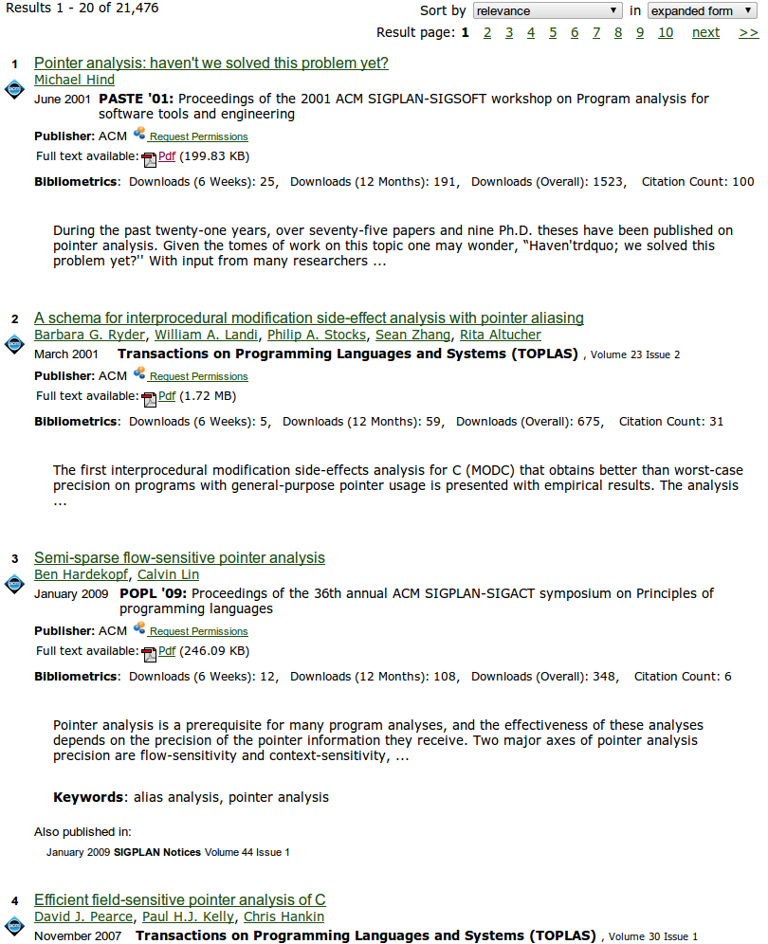
Program Analysis: A Complex Domain
flow-sensitive
inclusion-based
unification-based
k-cfa
object-sensitive
context-sensitive
field-based
field-sensitive
BDDs
heap-sensitive

Slide 55
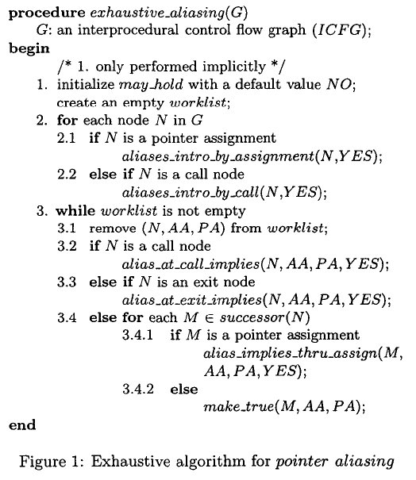
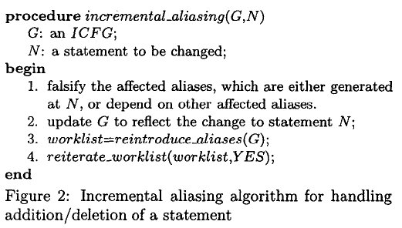
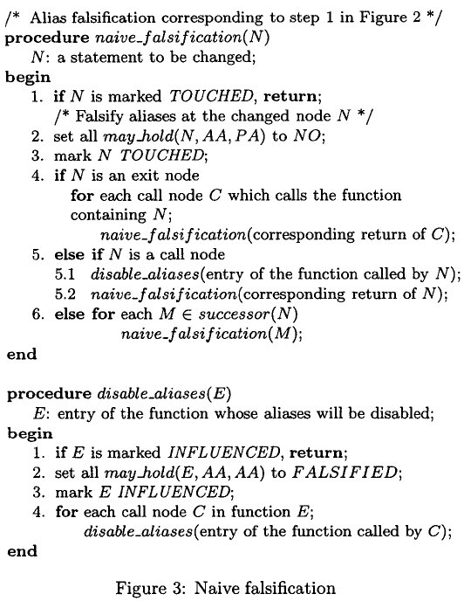
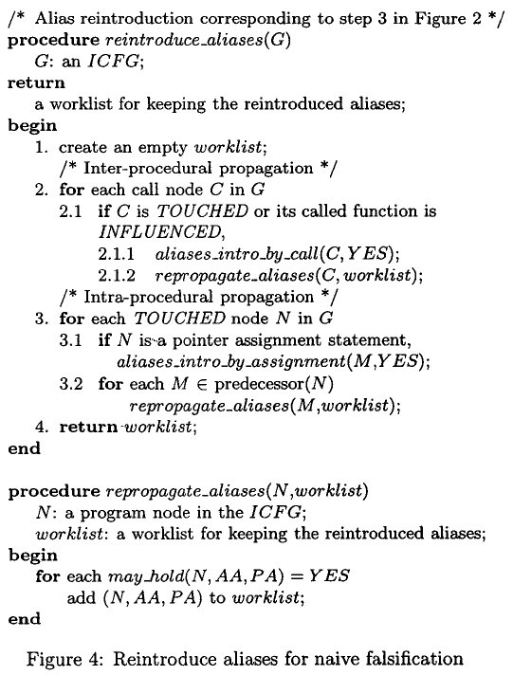
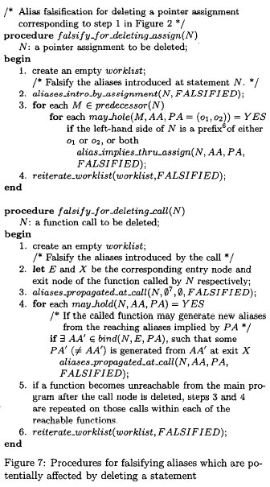
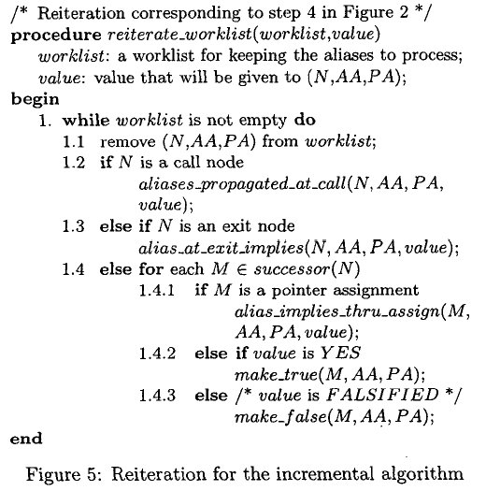
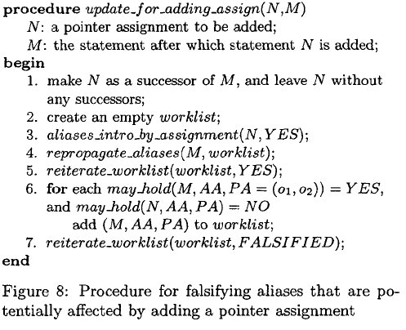
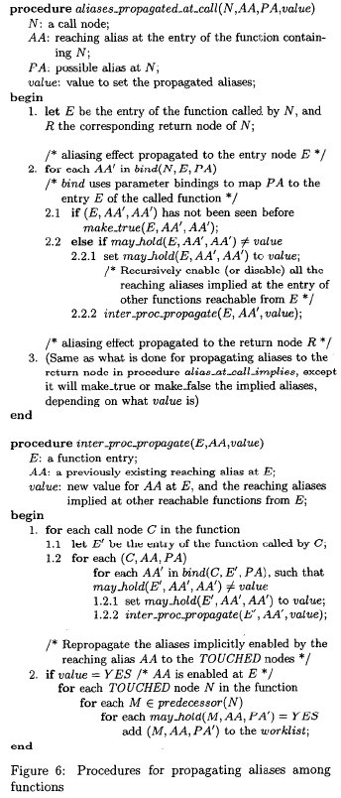
Algorithms in 10-page Conf. Papers
variaton points unclear
every variaton new algorithm
correctness unclear
incomparable in precision
incomparable in performance

Slide 56
Want: Specification + Implementation
Specifications
Implementation
Declarative
Language Runtime
Notes:
Specification: variation in precision clearer, correctness easier to verify. Language runtime: should generate algorithms that run fast!

Slide 57
Why datalog?
Declarative = GOOD

Slide 58
Program Analysis: Domain of Mutual Recursion
x = y;
x = f();
x = y.f();
x.f = y;
x = y.f;
throw e
catch (E e)
g()
var points-to
exceptions
call graph
fields points-to

Slide 59
A Brief History of Datalog
Declarative networking
Control + data flow
BDDBDDB
SecureBlox
Orchestra CDSS
Workshop on Logic and Databases
Data integration
Information Extraction
‘77
’80s …
‘95
‘02
‘05
‘07
‘08
‘10
Doop
(pointer-analysis)
Access control (Binder)
LDL, NAIL, Coral, ...
Evita Raced
.QL
Notes:
Add recursion quote of

Slide 60
Program Analysis in Datalog

Slide 61
Points-to Analyses for A Simple Language
What objects can a variable point to?
program
assignObjectAllocation
a = new A();
b = new B();
c = new C();
a = b;
b = a;
c = b;
a | new A()
b | new B()
c | new C()
assign
b | a
a | b
b | c

Slide 62
Defining varPointsTo
program
assignObjectAllocation
varPointsTo
a = new A();
b = new B();
c = new C();
a = b;
b = a;
c = b;
a | new A()
a | new A()
b | new B()
b | new B()
c | new C()
c | new C()
assign
a | new B()
b | a
b | new A()
a | b
c | new B()
b | c
c | new A()
varPointsTo(Var, Obj)
<- assignObjectAllocation(Var,Obj).
varPointsTo(To, Obj)
<- assign(From, To), varPointsTo(From,Obj).
Notes:
This part can be interactive.
Add code from Paddle

Slide 63
Introducing Fields
storeField
program
b | a | F1
a.F1 = b;
c = b.F2;
loadField
b | F2 | c
BaseObj.Fld
Obj
fieldPointsTo(BaseObj, Fld, Obj)
<- storeField(From, Base, Fld),
varPointsTo(Base, BaseObj),
varPointsTo(From, Obj).
Base.Fld = From
Enhance specification without changing base code
Obj
BaseObj.Fld
varPointsTo(To, Obj)
<- loadField(Base, Fld, To),
varPointsTo(Base, BaseObj),
fieldPointsTo(BaseObj, Fld, Obj).
To = Base.Fld
63

Slide 64
Specification + Implementation
Specifications
Implementation
varPointsTo(Var, Obj)
<- assignObjectAllocation(…).
Control
Top-down
Bottom-up
Doop:
~2500 lines of logic
varPointsTo(To, Obj)
<- assign(From, To),
varPointsTo(From,Obj).
Does It Run Fast?!?
Tabled
Naive
DatalogEngine
Semi-naive
fieldPointsTo(BaseObj, Fld, Obj)
<- storeField(From,Base,Field),
varPointsTo(Base, BaseObj),
varPointsTo(From, Obj).
Counting
DReD
Data Structures
varPointsTo(To, Obj)
<- loadField(Base, Field, To),
varPointsTo(Base, BaseObj),
fieldPointsTo(BaseObj, …).
BTree
BDDs
transitive
closure
KDTree

Slide 65
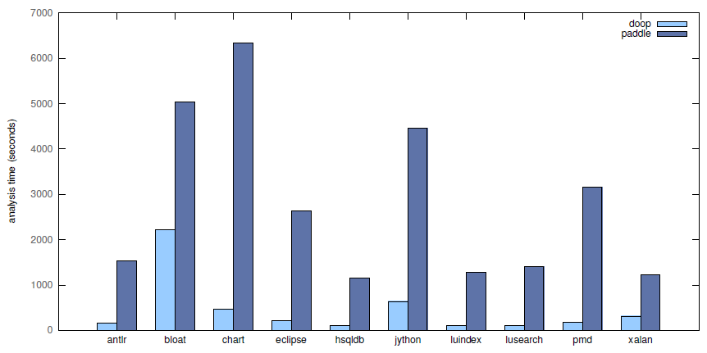
Doop vs. Paddle: 1-call-site-sensitive-heap

Slide 66
Crucial Optimizations
something old
semi-naïve evaluation, folding, index selection
something new(-ish)
magic-sets
something borrowed (from PL)
type-based

Slide 67
Type-based Optimizations

Slide 68
Types: Sets of Values
universe
pet
dog
bird
animal(X) -> .
bird(X) -> animal(X) .
animal
food
dog(X) -> animal(X) .
dog(X) -> !bird(X).
bird(X) -> !dog(X).
thing
pet(X) -> animal(X).

Slide 69
“Virtual Call Resolution”
query _(D)
<- dog(D), eat(D, Thing),
food(Thing),
chocolate(Thing).
query _(D)
<- dog(D), eat(D, Thing),
food(Thing),
chocolate(Thing).
query _(D)
<- dog(D), eat(D, Thing),
food(Thing),
chocolate(Thing).
D :: dog
eat(A, Food)
<- dogChews(A,Food)
; birdSwallows(A,Food).
dogChews :: (dog, food)
birdSwallows :: (bird, food)

Slide 70
Type Erasure
query _(D)
<- dog(D), eat(D, Thing),
food(Thing),
chocolate(Thing).
query _(D)
<- dog(D), eat(D, Thing),
food(Thing),
chocolate(Thing).
D :: dog
Thing :: chocolate
eat(A, Food)
<- dogChews(A,Food)
; birdSwallows(A,Food).
dogChews :: (dog, food)
eat :: (dog, food)
birdSwallows :: (bird, food)

Slide 71
Clean Up
query _(D)
<- dog(D), eat(D, Thing),
food(Thing),
chocolate(Thing).
query _(D)
<- dog(D), eat(D, Thing),
food(Thing),
chocolate(Thing).
query _(D)
<- eat(D,Thing),
chocolate(Thing).
D :: dog
Thing :: chocolate
eat(A, Food)
<- dogChews(A,Food)
; birdSwallows(A,Food).
eat(A, Food)
<- dogChews(A,Food).
eat :: (dog, food)

Slide 72
References on Datalog and Types
“Type inference for datalog and its application to query optimisation”, de Moor et al., PODS ‘08
“Type inference for datalog with complex type hierarchies”, Schafer and de Moor, POPL ‘10
“Semantic Query Optimization in the Presence of Types”, Meier et al., PODS ‘10

Slide 73
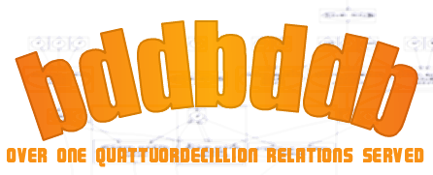


Datalog Program Analysis Systems
BDDBDDB
Data structure: BDD
Semmle (.QL)
Object-oriented syntax
No update
Doop
Points-to analysis for full Java
Supports for many variants of context and heap sensitivity.

Slide 74
Review

Slide 75
Program Analysis
What is it?
Fundamental analysis aiding software development
Help make programs run fast, help you find bugs
Why in Datalog?
Declarative recursion
How does it work?
Really well! order of magnitude faster than hand-tuned, Java tools
Datalog optimizations are crucial in achieving performance

Slide 76
Program Analysis
logic
imperative
functional
Datalog
understanding program behavior
^
“Evita Raced: Meta-compilation for declarative networks”, Condie et al., VLDB ‘08

Slide 77
Open Challenges

Slide 78
Traditional View Datalog: Data Querying Language
UI Logic + Rendering
Java
OracleForms
…
JavaScript
Application Logic
Java
C++
…
Ruby
Middleware
Queries

Slide 79
New View Datalog: General Purpose Language
UI Rendering
UI Logic
UI Logic
App. Logic
App. Logic
App. Logic
Queries

Slide 80
Challenges Raised by Program Analysis
Datalog Programming in the large
Modularization support
Reuse (generic programming)
Debugging and Testing
Expressiveness:
Recursion through negation, aggregation
Declarative state
Optimization, optimization, optimization
In the presence of recursion!

Slide 81
Acknowledgements
Slides:
Martin Bravenboer & LogicBlox, Inc.
Damien Sereni & Semmle, Inc.
Matt Might, University of Utah

Slide 82
Outline of Tutorial
June 14, 2011: The Second Coming of Datalog!
Refresher: basics of Datalog
Application #1: Data Integration and Exchange
Application #2: Program Analysis
Application #3: Declarative Networking
Conclusions

Slide 83
Declarative Networking
A declarative framework for networks:
Declarative language: “ask for what you want, not how to implement it”
Declarative specifications of networks, compiled to distributed dataflows
Runtime engine to execute distributed dataflows
Observation: Recursive queries are a natural fit for routing

Slide 84
A Declarative Network
messages
Dataflow
Dataflow
messages
Dataflow
messages
Dataflow
Dataflow
Distributed recursive query
Dataflow
Traditional Networks
Declarative Networks
Network State
Distributed database
Network protocol
Recursive Query Execution
Network messages
Distributed Dataflow

Slide 85
Declarative* in Distributed Systems Programming
IP Routing [SIGCOMM’05, SIGCOMM’09 demo]
Overlay networks [SOSP’05]
Network Datalog [SIGMOD’06]
Distributed debugging [Eurosys’06]
Sensor networks [SenSys’07]
Network composition [CoNEXT’08]
Fault tolerant protocols [NSDI’08]
Secure networks [ICDE’09, NDSS’10, SIGMOD’10]
Replication [NSDI’09]
Hybrid wireless routing [ICNP’09], channel selection [PRESTO’10]
Formal network verification [HotNets’09, SIGCOMM’11 demo]
Network provenance [SIGMOD’10, SIGMOD’11 demo]
Cloud programming [Eurosys ‘10], Cloud testing (NSDI’11)
… <More to come>
Databases (5)
Networking (11)
Security (1)
Systems (2)

Slide 86
Open-source systems
P2 declarative networking system
The “original” system
Based on modifications to the Click modular router.
http://p2.cs.berkeley.edu
RapidNet
Integrated with network simulator 3 (ns-3), ORBIT wireless testbed, and PlanetLab testbed.
Security and provenance extensions.
Demonstrations at SIGCOMM’09, SIGCOMM’11, and SIGMOD’11
http://netdb.cis.upenn.edu/rapidnet
BOOM – Berkeley Orders of Magnitude
BLOOM (DSL in Ruby, uses Dedalus, a temporal logic programming language as its formal basis).
http://boom.cs.berkeley.edu/

Slide 87
Network Datalog
Location Specifier “@S”
R1: reachable(@S,D) <- link(@S,D)
R2: reachable(@S,D) <- link(@S,Z), reachable(@Z,D)
query _(@M,N) <- reachable(@M,N)
query _(@a,N) <- reachable(@a,N)
All-Pairs Reachability
link
link
link
link
Input table:
@S | D
@a | b
@S | D
@b | c
@b | a
@S | D
@c | b
@c | d
@S | D
@d | c
a
b
c
d
reachable
reachable
reachable
reachable
Output table:
@S | D
@a | b
@a | c
@a | d
@S | D
@b | a
@b | c
@b | d
@S | D
@c | a
@c | b
@c | d
@S | D
@d | a
@d | b
@d | c
Query: reachable(@a,N)

Slide 88
Implicit Communication
A networking language with no explicit communication:
R2: reachable(@S,D) <- link(@S,Z), reachable(@Z,D)
Data placement induces communication

Slide 89
Path Vector Protocol Example
Advertisement: entire path to a destination
Each node receives advertisement, adds itself to path and forwards to neighbors
path=[a,b,c,d]
path=[b,c,d]
path=[c,d]
a
b
c
d
b advertises [b,c,d]
c advertises [c,d]

Slide 90
Path Vector in Network Datalog
R1: path(@S,D,P) <- link(@S,D), P=(S,D).
<-
path(@Z,D,P₂),
P=S•P₂.
R2:
path(@S,D,P)
link(@Z,S),
query _(@S,D,P) <- path(@S,D,P)
Add S to front of P₂
Input: link(@source, destination)
Query output: path(@source, destination, pathVector)
Courtesy of Bill Marczak (UC Berkeley)

Slide 91
Query Execution
R1: path(@S,D,P) <- link(@S,D), P=(S,D).
R2: path(@S,D,P) <- link(@Z,S), path(@Z,D,P₂), P=S•P₂.
query _(@a,d,P) <- path(@a,d,P)
link
link
link
link
Neighbor table:
@S | D
@a | b
@S | D
@b | c
@b | a
@S | D
@c | b
@c | d
@S | D
@d | c
a
b
c
d
path
path
path
@S | D | P
@S | D | P
@S | D | P
@c | d | [c,d]
Forwarding table:
@S | D | P

Slide 92
Query Execution
R1: path(@S,D,P) <- link(@S,D), P=(S,D).
R2: path(@S,D,P) <- link(@Z,S), path(@Z,D,P₂), P=S•P₂.
query _(@a,d,P) <- path(@a,d,P)
Matching variable Z = “Join”
link
link
link
link
Neighbor table:
@S | D
@b | c
@b | a
Communication patterns are identical to those in the actual path vector protocol
@S | D
@a | b
@S | D
@c | b
@c | d
@S | D
@d | c
a
b
c
d
path(@a,d,[a,b,c,d])
path(@b,d,[b,c,d])
path
path
path
@S | D | P
@S | D | P
@a | d | [a,b,c,d]
@S | D | P
@b | d | [b,c,d]
Forwarding table:
@S | D | P
@S | D | P
@c | d | [c,d]

Slide 93
All-pairs Shortest-path
R1: path(@S,D,P,C) <- link(@S,D,C), P=(S,D).
R2: path(@S,D,P,C) <- link(@S,Z,C₁), path(@Z,D,P₂,C₂), C=C₁+C₂,
query_(@S,D,P,C) <- bestPath(@S,D,P,C)
P=S•P₂.
R3: bestPathCost(@S,D,min<C>) <- path(@S,D,P,C).
R4: bestPath(@S,D,P,C) <- bestPathCost(@S,D,C), path(@S,D,P,C).

Slide 94
Distributed Semi-naïve Evaluation
Semi-naïve evaluation:
Iterations (rounds) of synchronous computation
Results from iteration i^{th} used in (i+1)^{th}
10
9
9
3-hop
7
8
5
7
4
1
2
10
6
8
0
5
2-hop
4
3
3
2
1-hop
6
1
Link Table
Path Table
Network
Problem: How do nodes know that an iteration is completed? Unpredictable delays and failures make synchronization difficult/expensive.

Slide 95
Pipelined Semi-naïve (PSN)
Fully-asynchronous evaluation:
Computed tuples in any iteration are pipelined to next iteration
Natural for distributed dataflows
9
10
7
9
5
6
4
1
2
10
3
Relaxation of semi-naïve
8
8
0
5
3
2
7
6
4
1
Link Table
Path Table
Network

Slide 96
Dataflow Graph
Strands
Network In
Network Out
Messages
Messages
Single Node
Nodes in dataflow graph (“elements”):
Network elements (send/recv, rate limitation, jitter)
Flow elements (mux, demux, queues)
Relational operators (selects, projects, joins, aggregates)

Slide 97
Rule → Dataflow “Strands”
R2: path(@S,D,P) <- link(@S,Z), path(@Z,D,P₂),
P=S•P2.

Slide 98
Localization Rewrite
Rules may have body predicates at different locations:
R2: path(@S,D,P) <- link(@S,Z), path(@Z,D,P₂), P=S•P₂.
Matching variable Z = “Join”
Rewritten rules:
R2a: linkD(S,@D) ← link(@S,D)
R2b: path(@S,D,P) ← linkD(S,@Z), path(@Z,D,P₂), P=S•P₂.
Matching variable Z = “Join”

Slide 99
Physical Execution Plan
R2b: path(@S,D,P) <- linkD(S,@Z), path(@Z,D,P₂), P=S•P₂.
Strand Elements
Network In
Network In
Δpath
Join
path.Z = linkD.Z
Project
path(S,D,P)
Send to path.S
linkD
ΔlinkD
Join
linkD.Z = path.Z
Project
path(S,D,P)
Send to path.S
path

Slide 100
Pipelined Evaluation
Challenges:
Does PSN produce the correct answer?
Is PSN bandwidth efficient?
I.e. does it make the minimum number of inferences?
Theorems [SIGMOD’06]:
RS_{SN}(p) = RS_{PSN}(p), where RS is results set
No repeated inferences in computing RS_{PSN}(p)
Require per-tuple timestamps in delta rules and FIFO and reliable channels

Slide 101
Incremental View Maintenance
Leverages insertion and deletion delta rules for state modifications.
Complications arise from duplicate evaluations.
Consider the Reachable query. What if there are many ways to route between two nodes a and b, i.e. many possible derivations for reachable(a,b)?
Mechanisms: still use delta rules, but additionally, apply
Count algorithm (for non-recursive queries).
Delete and Rederive (SIGMOD’93). Expensive in distributed settings.
Maintaining Views Incrementally. Gupta, Mumick, Ramakrishnan, Subrahmanian. SIGMOD 1993.

Slide 102
Recent PSN Enhancements
Provenance-based approach
Condensed form of provenance piggy-backed with each tuple for derivability test.
Recursive Computation of Regions and Connectivity in Networks. Liu, Taylor, Zhou, Ives, and Loo. ICDE 2009.
Relaxation of FIFO requirements:
Maintaining Distributed Logic Programs Incrementally. Vivek Nigam, Limin Jia, Boon Thau Loo and Andre Scedrov. 13th International ACM SIGPLAN Symposium on Principles and Practice of Declarative Programming (PPDP), 2011.
Notes:
Minimal models.

Slide 103
Optimizations
Traditional:
Aggregate Selections
Magic Sets rewrite
Predicate Reordering
New:
Multi-query optimizations:
Query Results caching
Opportunistic message sharing
Cost-based optimizations
Network statistics (e.g. density, route request rates, etc.)
Combining top-down and bottom-up evaluation
PV/DV → DSR

Slide 104
Suggested Readings
Networking use cases:
Declarative Routing: Extensible Routing with Declarative Queries. Loo, Hellerstein, Stoica, and Ramakrishnan. SIGCOMM 2005.
Implementing Declarative Overlays. Loo, Condie, Hellerstein, Maniatis, Roscoe, and Stoica. SOSP 2005.
Distributed recursive query processing:
*Declarative Networking: Language, Execution and Optimization. Loo, Condie, Garofalakis, Gay, Hellerstein, Maniatis, Ramakrishnan, Roscoe, and Stoica, SIGMOD 06.
Recursive Computation of Regions and Connectivity in Networks. Liu, Taylor, Zhou, Ives, and Loo. ICDE 2009.

Slide 105
Challenges and Opportunities
Declarative networking adoption:
Leverage well-known open-source software-based projects, e.g. ns-3, Quagga, OpenFlow
Wrappers for legacy code
Usability studies
Open-source code release and demonstrations
Formal network verification:
Integration of formal tools (e.g. theorem provers, SMT solvers), formal network models (e.g. routing algebra)
Operational semantics of Network Datalog and subsequent extensions
Other properties: timing, security
Opportunities for automated program synthesis

Slide 106
Outline of Tutorial
June 14, 2011: The Second Coming of Datalog!
Refresher: basics of Datalog
Application #1: Data Integration and Exchange
Application #2: Program Analysis
Application #3: Declarative Networking
Modern System Implementations
Open Questions

Slide 107
Modern Academic and Commercial Datalog Engines

Slide 108




Academic
IRIS Reasoner
Negation and function symbols
Locally stratified negation, well-founded semantics
http://www.iris-reasoner.org/
P2/RapidNet declarative networking (2005 - present)
Semantics: Datalog with distribution
Evaluation: Pipelined semi-naïve evaluation
Bloom (2009 – present)
Datalog with time: next, prev, async
Orchestra (2005 – present)
Datalog for p2p data integration with provenance support
Evaluation: Pipelined semi-naïve evaluation

Slide 109
Commercial
LogicBlox
Enterprise decision automation, analytics, and planning
Incremental view maintenance, notion of time, insert/delete/update, modules, generic programming
Semmle
Program analysis
Sophisticated optimizations: magic sets, type-based, index creation, folding, etc.
Lixto
Web site screen scraping (Datalog on html trees)
Commercial databases
SQL-99: all major vendors (IBM, Microsoft, Oracle).

Slide 110
Open Issues

Slide 111
Outline of Tutorial
June 14, 2011: The Second Coming of Datalog!
Refresher: basics of Datalog
Application #1: Data Integration and Exchange
Application #2: Program Analysis
Application #3: Declarative Networking
Conclusions

Slide 112
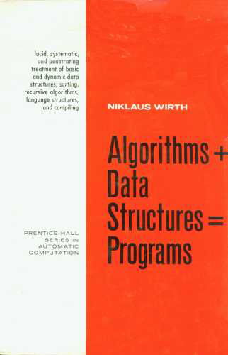
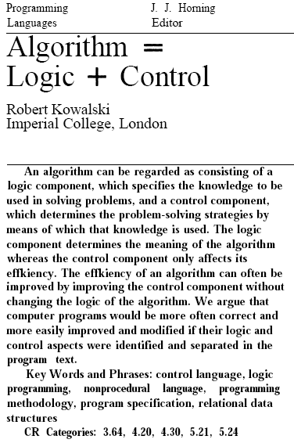
What Is A Program?
program
=
algorithms
+
data structures
algorithm
=
logic
+
control

Slide 113
Logic + Control + Data Structures
Specifications
Implementation
Control
Top-down
Bottom-up
Tabled
Naive
DatalogEngine
Semi-naive
Counting
DReD
Data Structures
BTree
BDDs
transitive
closure
KDTree

Slide 114
The End… Or Is it the beginning?

Slide 115
Backup

Slide 116



Slide 117
Aggregate Selections
Prune communication using running state of monotonic aggregate
Avoid sending tuples that do not affect value of agg
E.g., shortest-paths query
Challenge in distributed setting:
Out-of-order (in terms of monotonic aggregate) arrival of tuples
Solution: Periodic aggregate selections
Buffer up tuples, periodically send best-agg tuples

Slide 118




Academic
Coral (1990 – 1997)
Semantics: insert/delete/update, modules, multisets
Evaluation: magic sets, indexing, materialization
LDL++ (? – 1999)
Semantics: complex terms, multisets, user-defined aggregates, updates
Evaluation: top-down evaluation
RapidNet declarative networking (2007 - present)
Semantics: Datalog with distribution
Evaluation: Pipelined semi-naïve evaluation
Bloom (2009 – present)
Semantics: Datalog with time: next, prev, async

Slide 119
Other Relevant References
Magic sets
“Cost-based Optimization for Magic: Algebra and Implementation”, Seshadri et al., SIGMOD ’96
“Adding Magic to an Optimising Datalog Compiler”, Sereni, Avgustinov, and de Moor, SIGMOD ’08
Program analysis with Datalog
“Strictly Declarative Specification of Sophisticated Points-to Analyses”, Bravenboer et al., OOPSLA ’08
“Context Sensitive Program Analysis as Database Queries”, Lam et al., PODS ‘05

Slide 120
Many Ways To Analyze Programs
points-to
abstract interpretation
type-based
pattern-based

Slide 121
Points-to Analysis
what objects can a variable point to?
program
foo:a | new A1()
bar:a | new A2()
void foo() {
a = new A1();
b = id(a);
}
void bar() {
a = new A2();
b = id(a);
}
A id(A a) {
return a;
}
points-to
id:a | new A1(), new A2()
foo:b | new A1(), new A2()
bar:b | new A1(), new A2()
foo:a | new A1()
bar:a | new A2()
id:a (foo) | new A1()
id:a (bar) | new A2()
context-sensitive
foo:b | new A1()
bar:b | new A2()
Notes:
One of the things that Datalog allows us to do is to quickly experiment with different ways to tune the precision of the analysis. It also scales

Slide 122

A Practical Approach: Pattern-Based
find coding patterns that determine program behavior, regardless of input
class Animal {
public boolean equals(Object o) { … }
}
class Dog extends Animal {
public boolean equals(Dog o) { … }
}
Notes:
Say: there are many patterns that may not be covered by the OTS tool. Using datalog, prgorammers like you can write patterns that interest you, patterns that may indicate bugs, or bad programming habit, but may be just fine for somebody else

Slide 123
static structure of program
do all classes satisfy framework extension constraint?
framework class
class ASTNode {
void visitChildren() {}
}
client class
client class
class Constant extends ASTNode {
String _value;
…
}
class Plus extends ASTNode {
Constant _left;
Constant _right;
}

Slide 124
static structure of program
framework class
class ASTNode {
void visitChildren() {}
}
client class
client class
class Constant extends ASTNode {
String _value;
…
}
class Plus extends ASTNode {
Constant _left;
Constant _right;
}

Slide 125
program as data
class(C)
className(C | N)
hasSupertype(C | S)
1
1 | “Object”
2 | 1
2
2 | “ASTNode”
3 | 2
3
3 | “Plus”
4 | 2
4
4 | “Constant”
5 | 1
5
5 | “String”
hasChild(C | Cld)
… | …
method(M)
…
field(F)
…
hasType(F | T)
… | …
_query(CN) <-
class(C), hasName(C,CN),
hasSupertype(C,S), hasName(S,”ASTNode”),
!implementVisitChild(C).
Notes:
This part needs to be interactive. TODO: 1) prep work: Need skeleton code, and pre-made data files?
2) Interactive part: define implementVisitChild & hasSupertype on the fly

Slide 126
Pattern-Based Analysis
program
class
hasName
hasSupertype
class Animal {
public boolean
equals(Object o) { … }
}
1
1 | “Animal”
1 | 3
2
2 | “Dog”
2 | 1
3
3 | “Object”
method
4 | “equals”
hasMethod
class Dog extends Animal {
public boolean
equals(Dog d) { … }
}
New patterns easy to define
4
5 | “equals”
1 | 4
5
2 | 5
query _badEquals(CName)
<- class(C), hasName(C, CName),
implEqualsWithArgType(C,A),
hasSupertypePlus(A,O),
class(O), hasName(O, “Object”).
implEqualsWithArgType(C,A)
<- class(C), hasMethod (C,M),
method(M),
hasName(M, “equals”),
method_argType[M,0]=A.

Slide 127
magic by example
_bad(CN)
<- class(S), hasName(S,”ASTNode”),
hasSubtypePlus(S,C),
class(C), hasName(C,CN),
!implementVisitChild(C).
rewrite queries to use guarded IDBs
hasSubtypePlus(Super,Sub)
<- hasSubtype(Super,Sub).
hasSubtypePlus(Super,Sub)
<- hasSubtypePlus(Super,Mid), hasSupertype(Mid,Sub).
generate rules guarded by “context” from queries
implementVisitChild(C)
<- hasChild(C,M), method(M),
hasName(M,”visitChild”).
Notes:
TODO: get number of hasSubtypePlus tuples for java core library to make a point

Slide 128
generate rules using context
_bad(CN)
<- class(S), hasName(S,”ASTNode”),
hasSubtypePlus(S,C),
class(C), hasName(C,CN),
!implementVisitChild(C).
rewrite queries to use guarded IDBs
“adorned” predicate
hasSubtypePlus(Super,Sub)
<- hasSubtype(Super,Sub).
hasSubtypePlus(Super,Sub)
<- hasSubtypePlus(Super,Mid), hasSupertype(Mid,Sub).
hasSubtypePlus_bf(Super,Sub)
<- hasSubtype(Super,Sub).
hasSubtypePlus_bf(Super,Sub)
<- hasSubtypePlus_bf(Super,Mid), hasSupertype(Mid,Sub).
hasSubtypePlus_bf(Super,Sub)
<- class(S), hasName(S,”ASTNode”),
hasSubtype(Super,Sub).
hasSubtypePlus_bf(Super,Sub)
<- hasSubtypePlus_bf(Super,Mid), hasSupertype(Mid,Sub).
hasSubtypePlus_bf(Super,Sub)
<- class(S), hasName(S,”ASTNode”),
hasSubtype(Super,Sub).
hasSubtypePlus_bf(Super,Sub)
<- class(S), hasName(S,”ASTNode”),
hasSubtypePlus_bf(Super,Mid), hasSupertype(Mid,Sub).
hasSubtypePlus_bf(Super,Sub)
<- magic_hasSubtypePlus_bf(Super)
hasSubtype(Super,Sub).
hasSubtypePlus_bf(Super,Sub)
<- magic_hasSubtypePlus_bf(Super),
hasSubtypePlus_bf(Super,Mid), hasSupertype(Mid,Sub).
the magic set!
generate rules guarded by “context” from queries
implementVisitChild(C)
<- hasChild(C,M), method(M),
hasName(M,”visitChild”).
magic_hasSubtypePlus_bf(S)
<- class(S), hasName(S,”ASTNode”).

Slide 129
rewrite query
_bad(CN)
<- class(S), hasName(S,”ASTNode”),
hasSubtypePlus(S,C),
class(C), hasName(C,CN),
!implementVisitChild(C).
_bad(CN)
<- class(S), hasName(S,”ASTNode”),
hasSubtypePlus_bf(S,C),
class(C), hasName(C,CN),
!implementVisitChild(C).
hasSubtypePlus_bf(Super,Sub)
<- magic_hasSubtypePlus_bf(Super)
hasSubtype(Super,Sub).
hasSubtypePlus_bf(Super,Sub)
<- magic_hasSubtypePlus_bf(Super),
hasSubtypePlus_bf(Super,Mid), hasSupertype(Mid,Sub).
magic_hasSubtypePlus_bf(S)
<- class(S), hasName(S,”ASTNode”).

Slide 130
steps to achieve magic
rewrite queries to use “adorned” versions of IDB predicates
for every adorned predicate p_a, create magic_p_a
for every occurrence of p_a in every rule body, create a rule defining magic_p_a
modify every rule by adding magic_p_a
seed magic_p_a with constants from queries

Slide 131
types
an approximation of program runtime behavior
Animal
Vehicle
Dog aDog = new Dog();
Animal animal = aDog;
Animal a = new Vehicle();
Animal a
= (Animal) new Vehicle();
Dog
Car
approximates (soundly) containment
foo(A)
<- Animal(A),
Dog(A),
something(A).
foo(A)
<- Dog(A), something(A).
approximates (soundly) emptiness
something(A)
<- Vehicle(A) ; Dog(A) .

Slide 132
Magic Sets

Slide 133
Magic by Example
query _badEquals(CName)
<- class(C), hasName(C, CName),
implEqualsWithArgType(C,A),
hasSupertypePlus(A,O),
class(O), hasName(O, “Object”).
implEqualsWithArgType(C,A)
<- class(C), hasMethod(C,M),
method(M),
hasName(M, “equals”),
method_argType[M,0]=A.
rewrite queries to use rewritten rules
hasSupertypePlus(Sub,Super)
<- hasSupertype(Sub,Super).
hasSupertypePlus(Sub,Super)
<- hasSupertypePlus(Sub,Mid),
hasSupertype(Mid,Suuper).
push “context” from queries into rules
Notes:
Say it’s like pushing selections

Slide 134
Applying Magic
query _badEquals(CName)
<- class(C), hasName(C, CName),
implEqualsWithArgType(C,A),
hasSupertypePlus(A,O),
class(O), hasName(O, “Object”).
query _badEquals(CName)
<- class(C), hasName(C, CName),
implEqualsWithArgType(C,A),
hasSupertypePlus_bf(A,O),
class(O), hasName(O, “Object”).
“adorned” predicate
hasSupertypePlus_bf(Sub,Super)
<- class(Sub), hasName(Sub, Sname),
implEqualsWithArgType(Sub,A),
hasSubtype(Sub,Super).
hasSupertypePlus_bf(Sub,Super)
<- hasSupertypePlus_bf(Sub,Mid),
hasSupertype(Mid,Suuper).
hasSupertypePlus_bf(Sub,Super)
<- class(Sub), hasName(Sub, Sname),
implEqualsWithArgType(Sub,A),
hasSubtype(Sub,Super).
hasSupertypePlus_bf(Sub,Super)
<- class(Sub), hasName(Sub, Sname),
implEqualsWithArgType(Sub,A),
hasSupertypePlus_bf(Sub,Mid),
hasSupertype(Mid,Suuper).
hasSupertypePlus_bf(Sub,Super)
<- magic_hasSupertypePlus_bf(Sub),
hasSubtype(Sub,Super).
hasSupertypePlus_bf(Sub,Super)
<- magic_hasSupertypePlus_bf(Sub),
hasSupertypePlus_bf(Sub,Mid),
hasSupertype(Mid,Suuper).
magic_hasSupertypePlus_bf(Sub)
<- class(Sub),
hasName(Sub, Sname),
implEqualsWithAType(Sub,A).
hasSupertypePlus(Sub,Super)
<- hasSubtype(Sub,Super).
hasSupertypePlus(Sub,Super)
<- hasSupertypePlus(Sub,Mid),
hasSupertype(Mid,Suuper).
hasSupertypePlus_bf(Sub,Super)
<- hasSubtype(Sub,Super).
hasSupertypePlus_bf(Sub,Super)
<- hasSupertypePlus_bf(Sub,Mid),
hasSupertype(Mid,Suuper).
the magic set!
Notes:
Say that it is optimal

Slide 135
Side-ways Information Passing Strategy (SIPS)
order matters
definition of magic set
Naïve application of magic on 111 queries
1-4x faster | 33 queries
Up to 2x slower | 55 queries
2-10x slower | 13 queries
> 10x slower | 10 queries
query _badEquals(CName)
<- class(C), hasName(C, CName),
implEqualsWithArgType(C,A),
hasSupertypePlus(A,O),
class(O), hasName(O, “Object”).
query _badEquals(CName)
<- hasSupertypePlus(A,O),
class(C), hasName(C, CName),
implEqualsWithArgType(C,A),
class(O), hasName(O, “Object”).
Sereni et al., SIGMOD ‘08

Slide 136
Type Specialization
query _badEquals(CName)
<- class(C), hasName(C, CName),
implEqualsWithArgType(C,A),
hasSupertypePlus(A,O),
class(O), hasName(O, “Object”).
query _badEquals(CName)
<- class(C), hasName(C, CName),
implEqualsWithArgType(C,A),
hasSupertypePlus(A,O),
class(O), hasName(O, “Object”).
query _badEquals(CName)
<- class(C), hasName(C, CName),
implEqualsWithArgType(C,A),
hasSupertypePlus(A,O),
class(O), hasName(O, “Object”).
query _badEquals(CName)
<- class(C), hasName(C, CName),
implEqualsWithArgType(C,A),
hasSupertypePlus(A,O),
class(O), hasName(O, “Object”).
C :: class
O :: class
hasName(C,N)
<- className(C,N)
; interfaceName(C,N)
; methodName(C,N).
className ::
( class, string )
hasName ::
( class, string )
interfaceName ::
( interface, string )
hasSupertype (Sub,Super)
<- extends(Sub,Super)
; implements(Sub,Super).
hasSupertype ::
( class, class)
136

Slide 137
Type Erasure
query _badEquals(CName)
<- class(C), hasName(C, CName),
implEqualsWithArgType(C,A),
hasSupertypePlus(A,O),
class(O), hasName(O, “Object”).
query _badEquals(CName)
<- hasName(C, CName),
implEqualsWithArgType(C,A),
hasSupertypePlus(A,O),
hasName(O, “Object”).
C :: class
O :: class
hasName(C,N)
<- className(C,N)
; interfaceName(C,N)
; methodName(C,N).
hasName(C,N)
<- className(C,N).
hasName ::
( class, string )
hasSupertype (Sub,Super)
<- extendeds(Sub,Super)
; implements(Sub,Super).
hasSupertype (Sub,Super)
<- extends(Sub,Super).
hasSupertype ::
( class, class)

Slide 138
Effectiveness of Optimizations
Time (s)
a sample Semmle analysis on Firefox
Queries sorted by runtime

Slide 139
Effectiveness of Optimizations
Time (s)
Queries sorted by runtime

Slide 140
Type-enabled Optimizations
class Dog {
void eat(Food f) { … }
}
it’s a Dog
it’s Chocolate
animal.eat( (Food) thing);
virtual call resolution
type erasure

